Slide 1

Mice Protein Expression
Made By-
Name - KAUSHAL GAWRI
Student Number - s3777121

Slide 2
AIM :-
The aim of the present investigation is to accomplish the following steps to complete modelling the given dataset on Mice Protein Expression(https://archive.ics.uci.edu/ml/datasets/Mice+Protein+Expression) : -
Retrieving the data from the given source.
Preparing the data for further investigation
Cleaning the data to make accurate models
Exploring the distribution of different attributes and relationships between them.
Building two different classification models to identify specific proteins that are discriminant between the classes and comparing the results of both the models

Slide 3
BRIEF REGARDING DATA SET
The provided dataset comprises of both numerical(and continuous ) and categorical features. The numerical features comprises of expression levels of 77 different proteins that produced some detectable signals in the fraction of cortex. The dataset provided to us, consists of a total of 1080 observations per protein considered as an independent sample and is confiscated from the UCI data repository.
Down Syndrome is considered as one of the foremost common hereditary innate causes of learning deficits.
There are around fifteen observations recorded of each protein per sample.
The eight classes of the mice are depicted based on some features such as genotype, behavior and treatment.
Genotype - Classifies mice to be either control or trisomic(trisomy is the presence of an extra copy of chromosome in the cell nuclei, causing developmental abnormalities)
Behavior – Either Context-Shock (Fortified to learn) or Shock-Context (Ain’t fortified to learn)
Treatment - Either injected with Memantine or Saline
Class - Depicting different combinations of the Genotype, Behavior and Treatment

Slide 4
BRIEF REGARDING DATA SET
The different classes are being shown in the table provided. To achieve our hypothesis and to build the required model, we would be focusing on how these classes are related to different kind of proteins and would be deriving interesting relationships to conclude our hypothesis and build the model with the most important features and highest accuracy.
c-CS-s | control mice, stimulated to learn, injected with saline
c-CS-m | control mice, stimulated to learn, injected with memantine
c-SC-s | control mice, not stimulated to learn, injected with saline
c-CS-m | control mice, not stimulated to learn, injected with memantine
t-CS-s | trisomy mice, stimulated to learn, injected with saline
t-CS-m | trisomy mice, stimulated to learn, injected with memantine
t-SC-s | trisomy mice, not stimulated to learn, injected with saline
t-SC-m | trisomy mice, not stimulated to learn, injected with memantine

Slide 5
DATA PREPARATION
Data preparation is basically one of the foremost step in the process of building a successful machine learning model. It is the process of cleaning and transforming the raw data prior to processing, analysis, exploration and building different machine learning models. To achieve this for my presentation investigation, the data was taken from the UCI repository,
Given, the data was provided in the xls format, I was required to convert it to suitable CSV file before starting the data cleaning process.
This was achieved with the help of Microsoft Excel
It was followed by reading the data from the CSV file with the help of pandas library in python.
This project is solely based on utilizing different python libraries and modules for our investigation

Slide 6
Data Preparation and Cleaning
The first step involved Data Retrieving:-
This was done using the pandas library of python as mentioned before once the file was converted to CSV format from xls using Microsoft Excel.
The next step involved checking for data types:-
This was accomplished by using pandas.DataFrame.dtypes to check for the datatypes of the given attributes. Most of the dataset contained continuous numerical data, specifically for different kind of proteins and some categorical features like Genotype, Treatment, Behavior and Class.
The next step involved checking for any extra whitespaces present in the data :-
It was performed using the pandas.Dataframe.value_counts() which basically checks for different types of values present in the categorical features. On performing the required tasks, we found out that there were no extra whitespaces present in the categorical features of our datasets.

Slide 7
Data Preparation And Cleaning
The next step involved checking for impossible values:-
It was completed using the pandas.Dataframe.value_counts() which sanity checks all the numerical data and tells us about the different values present. Using it I found out that there are no impossible values present, though after closely examining the numerical data, I did find out some outliers.
The last task for to check for any null/missing values in the data:-
It was done by invoking the pandas.Dataframe().isnull().sum() which tells us about the number of missing values present. This was further confirmed by using pandas.Dataframe().info() function. It was evident that there were quite a few null values present in the numerical data. The null values were then replaced by the mean of the respective protein to complete our data cleaning process.

Slide 8
DATA EXPLORATION
The next part of the process included exploring the data.
This first included exploring each column(or at least 10 columns if there are more), using appropriate descriptive statistics and graphs. For each explored column, I would be stating some conclusions that I can derive after the exploration and visualization was completed.
Exploring the relation between all pairs of attributes (here, as the number of attributes are quite high, I would be exploring a satisfactory amount of columns) with a plausible hypothesis clearly stating the reason for choosing them and stating if we reject or fail to reject the null hypothesis.

Slide 9
DATA EXPLORATION
Task 1: Exploring Few Columns Separately
The first step was to focus on the first task, that is to explore at least 10 columns using appropriate descriptive statistics and graphs.
To explore each column separately, I would be initially focussing on creating some meaningful plots, like the histograms which might be helpful in stating some meaningful conclusions derived from the shapes of the plots.
We basically tend to use histogram when we have continuous numerical measurements and we want to understand the distribution of values and check the outliers. The values in the histogram are displayed in the form of bins which are basically the continuous range of values for a particular attribute.
This was achieved by using the matplotlib library in python and the plots were customized as required.
Some proteins were explored by plotting the histograms which helped us in knowing if the numerical data provided is symmetric or not. If it is not symmetric, it further helped me in understanding the skewness of the data, if the data is positively or negatively skewed.
Some proteins were explored by plotting the box plots and violin plots for some similar proteins as they will suggest some more in depth hypothesis. violin plots and boxplots are quite similar, the main reason for using both the plots is that violin plots provides information about the probability density of the data at different values whereas it is quite easy to detect the outliers from the boxplots along with the mean and median values.
Some bar graphs and pie charts were plotted to get an insight about how the data is distributes amongst different groups of genotype, treatment, behavior and ultimately class

Slide 10
DATA EXPLORATION
Conclusion :-
Most of the plots, including all the histograms, violin plots and box plots suggested that though most of the attributes of different proteins had some sort of symmetric distribution, there were quite a few attributes having some kind of skewness(positive). It was concluded that the proteins which had symmetric distribution as seen in the histograms and the violin plots, such proteins had almost identical values of mean, median and mode whereas there were some proteins having a positively skewed distribution which suggested that the mean of such proteins was greater than its mode. Such descriptive statistics might help us during the model building process and derive a plausible hypothesis while exploring different attributes together

Slide 11
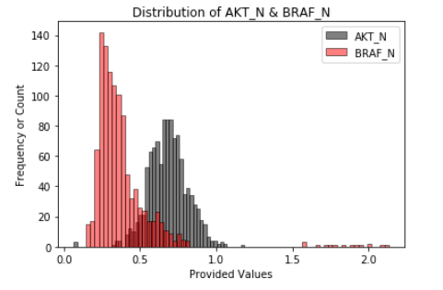
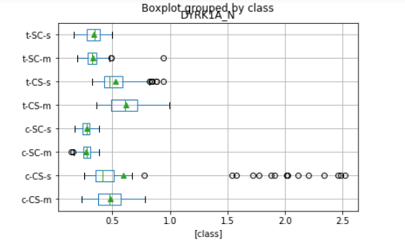
DATA EXPLORATION
Task 2: Exploring Different Pair of Columns with a given plausible hypothesis
The multivariate exploration included plotting two protein over a histogram to compare the symmetry present in the distribution which ultimately provides me with an insight on how the difference in some of the statistical values like the mean varies, with my null hypothesis being:-
First Null Hypothesis, H0A – There is no statistically significant difference between the means of different protein for the trisomic mice who are fortified to learn(CS) and who ain’t fortified to learn(SC) and are injected with Memantine
Second Null Hypothesis, H0B – It is expected that it is possible to divide the trisomy mice from the control mice.
To study my hypothesis in more detail I first plotted multiple histograms for two different proteins on a single graph to compare the symmetry of two different proteins which will further help me in comparing the means for the same. Given, the proteins either had a normal distribution or positively skewed, it is a tedious task to first divide the proteins into two categories and then compare the normal distribution with positively skewed(Impossible to compare normal-normal or skewed-skewed).
Figure 1 - Distribution of AKT_N and BRAF_N
Figure 2 - Boxplot of DYRK1A_N group by Class

Slide 12
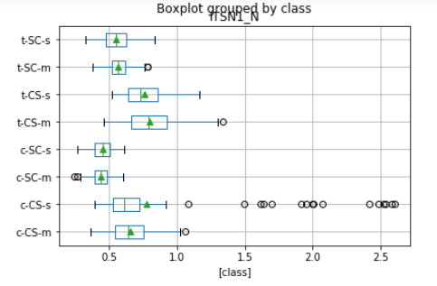
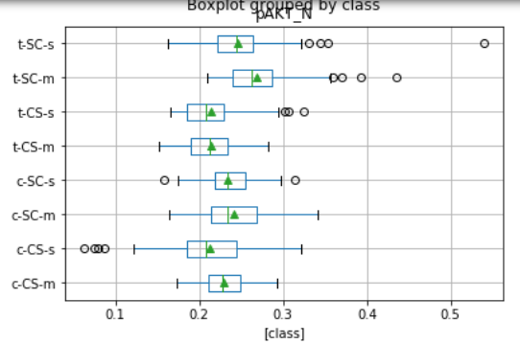
DATA EXPLORATION
Exploring different columns together was achieved with the help of matplotlib library. Basically, initially some histograms were made for adjacent attributes, given the skewness or symmetry was not pre determined, it ended up being a tedious task, as then I would have first separated the skewed and symmetric distributions and then explore them together.
To overcome it, and to analyse the null hypothesis, I further wanted to compare the mean values of different trisomic mice depending on if they are forced to learn or not, I plotted the data for a particular protein grouped by different classes(8 in total) on a box plots.
Some box plots were plotted for different proteins grouped by the classes which helped me in detecting any outliers present and getting an insight on some statistical values like the mean of such proteins divided by the classes. This will come handy to analyse my null hypothesis in a better way.
Figure 3 - Boxplot of ITSN1_N grouped by class
Figure 4 - Boxplot of pAKT_N grouped by class

Slide 13
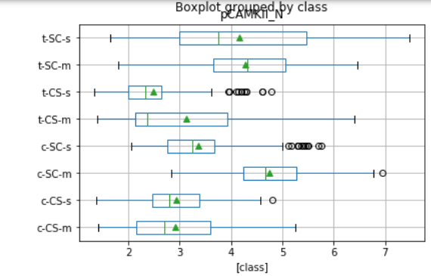
DATA EXPLORATION
From the plots provided, we can see in the boxplot the different means of a particular protein. We can see that there is a significant difference between the mean of some of the proteins for the trisomic mice depending on if they are simulated to learn or not. This further state that trisomic mice learn a lot better with the presence of some proteins like DYRK1A_N, whereas presence of proteins like pCAMKII_N doesn’t help in letting the mice learn. Based on this, we can say that the p-value must be less than 0.05 due to which I can conclude that I reject my first null hypothesis of there being no significant difference between the mean values of such mice.
Figure 5 - Boxplot of pCAMK11_N grouped by class

Slide 14
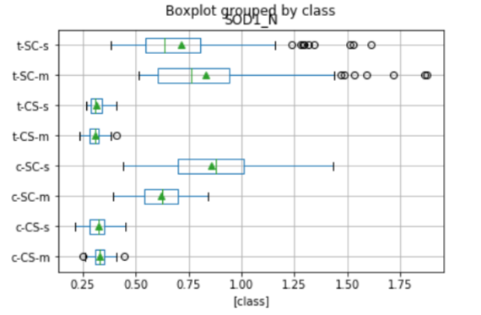
DATA EXPLORATION
From the figure shown, we can see that there is a huge difference between the mean values for different classes for trisomic and control mice, and hence we can conclude that it is feasible to divide the mice based on if they are trisomic and control mice. Presence of such proteins like SOD1_N, helps in differentiating the two Genotypes of mice and as, we conclude our second null hypothesis to be true, I declare that I fail to reject my null hypothesis, given the p values calculated would obviously be less than 0.05, which is enough to conclude that I fail to reject my null hypothesis two.
Figure 5 - Boxplot of SOD1_N grouped by class

Slide 15
DATA EXPLORATION
Conclusion :-
Hence, from the facts stated earlier and the graphs plotted, we can say that the p-value for some test cases would be less than 0.05 for the first null hypothesis, stating that there is no statistically significant difference between the means of different protein for the trisomic mice who are fortified to learn(CS) and who aren’t fortified to learn(SC) and are injected with Memantine. Hence, I reject my first null hypothesis, and can conclude that there is some significant difference between the mean values of some proteins for the trisomic mice who are fortified to learn(CS) and who are not fortified to learn(SC).
Also, from the above hypothesis, I can extend my conclusion and state that I fail to reject my second null hypothesis and conclude that it is expected that it is possible to divide the trisomy mice from the control mice.

Slide 16
DATA MODELING
WHAT IS DATA Modelling?
It is a process in the field of Machine learning. Machine learning algorithms build a mathematical model based on sample data, known as "training data", in order to make predictions or decisions without being explicitly programmed to do so.
This is done by selecting some suitable algorithms based on the problem statement. But before making the use of algorithm, the data is first split into test and train data, where test data works as the unseen future data. This is done using the sklearn library of python specifically build for building different machine learning models. The data is either first split into training and testing set or training and validating tests.
In my case, I would be using the sklearn.train_test_split to split the data in a particular ratio of test and train data.

Slide 17
DATA MODELING
The following steps are included to successfully build a machine learning model :-
Preparing the data (Already achieved in earlier stages)
Splitting the data into test and train samples
Choosing a suitable model
Training the data
Predicting over the test data – Evaluation
Hyper-Parameter Tuning
Feature Selection
Predicting the future data

Slide 18
DATA MODELING
Steps involved to successfully build a model:-
Splitting the data:-
The process of training our model starts by splitting the data into training and testing sets. Before splitting the data, I was required to achieve the training data, with the input data attributes(all the numerical columns), i.e., proteins to be the data used by the model to find patterns and predict to the target, which is the “class” attribute for first model. This is achieved with the help of train_test_split imported from the model_selection package of sklearn machine learning library of python. The training of the dataset to build predictive model was accomplished using python with the help of appropriate algorithms. Now, to split the data, we need to choose the test_size of data. In my case I would be splitting the data in the ratio of 80:20 to prevent overfitting because of the model that I would be building(mentioned in the next slide)

Slide 19
DATA MODELING
Choosing the model:-
As the task is to build a classification model, I would be building a Random Forest Classifier, which is basically a subset of well known Decision Tree. The major difference being that the RF classifier tend to choose the features in a very random manner whereas there is some bias in the case of decision tree for the features being chosen as it gives importance to a particular set of features.
Though, I am supposed to compare two different classification models, I would be building both the Random Forest Classifier and the Decision Tree classifier.

Slide 20
DATA MODELING
Training the model
The next step will include importing the RandomForestClassifier from sklearn.ensemble, and making a classification using the particular algorithm. Initially, the hyper parameters for the classifier include the value of,
n_estimators, to be equal to 100 (which is the default value), which is the number of trees in the forest.
random_state, to be equal to 1, which controls the sampling of the features to consider when looking for the best split at each node.
n_jobs, to be equal to 1, which is basically the default value of the number of jobs(here, fit and predict) to be ran in parallel.
With the use of default parameters and using all the features to build the model, I was able to achieve an accuracy of around 98.37% for my initial model

Slide 21
DATA MODELING
Hyper Parameter Tuning:-
still I wanted to tune the hyper parameters, to achieve a better accuracy without overfitting model. This was initially done using the GridSearchCV which provides an exhaustive search over specified parameter values. The specified parameter values were in turn taken from the values that were generated through the RandomizedSearchCV, which provided me with some values for different parameters. These values were then used in the GridSearchCV to train the model, which used around 4320 different combinations with the value of cross-validation generator(determines the cross-validation splitting strategy), of 3, making the total value of 12960 different parameter combinations. This took around 9 hours to train a single model, which in-turn is very exhaustive. Though, I gained the best fit values for the hyper parameters, with most of the values being stated to default and some increase values for hyper parameters like max_depth and n_estimators, I used a value of max_depth = 12, that is the depth of the tree and n_estimator = 1000, which are the number of trees to be built. As, using an algorithm to tune the hyper parameters for such dataset is exhaustive, I then manually filtered the parameters for the rest of the models to get the best fit values

Slide 22
DATA MODELING
Feature Selection:-
the next task involved selecting the best fit features(a.k.a attributes) for my model, which will indeed help in increasing the accuracy. To achieve it, I first imported the necessary libraries from the sklearn.feature_selection , the SelectFromModel package. In all the feature selection procedures, it is indeed a good practice to select the features by examining only the training set to avoid overfitting our model. This was followed by getting all the importance values of the given attributes, the protein’s in our case, using the feature_importances_, which will basically provide us with the importance values of all the features. This was followed by building a dataframe for the same. The next included making an instance of SelectFromModel by passing the classifier to it as a parameter and an appropriate value of threshold(which is the minimum value of the importance value for all the attributes to be considered). The threshold value was then adjusted manually using the hit and trail method, through which I discovered that the accuracy remains constant to a value of 99.074% if and only if 0.014<=threshold<=0.017. Hence, the average value of threshold(=0.0155) was selected, to train the SFM model.
This was then fitted on the training set and a new data set was created from the sfm model to test the accuracy with the most important features. This was then followed by creating a new classifier with similar hyper parameters, and then this new classifier was then allowed to fir over the newly generated training data. This was then followed by predicting the values for the “class” attribute over this newly generated data of important features and then the accuracy score was tested against the same.
The accuracy of the model was increased to 99.074% from 98.84%. Training a model and achieving an accuracy of around 99.074% to predict on the future data is splendid and I was indeed quite happy to successfully train and achieve such high accuracy

Slide 23
DATA MODELING
DECISION TREE:-
In the present investigation, next I was required to build another classification model, so that I can compare the model building time, features required and the accuracy for both the model. As, random forest is like a subset for Decision Tree Classifier, the next model that I built was hence a Decision Tree Classifier. The model building process included following similar steps, which required me to split the data in training and testing, tuning the hyper parameters either manually or by using suitable technique(depending on the training time) and selecting the most important features to get a best fit and most accurate model by reducing the probability of overfitting or underfitting the model.
The first task included splitting the data into training and testing with the target variable of “class” attribute. This time, I chose a size of 80:20, which is the most preferred, as the scikit learn library will given us 80% of the returns(bigger chunk of data) with the 20% of the work compared to rolling my own model. After splitting the data in desired portions, I am required to build a decision tree classifier with appropriate hyper parameters, which are derived by manually tuning the current ones and introducing the new ones to our classifier.

Slide 24
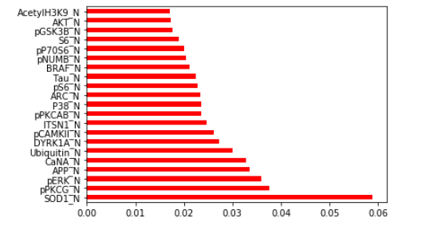
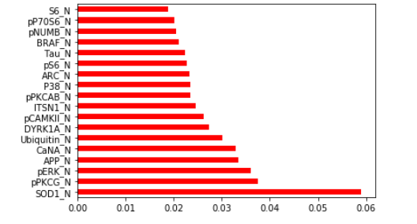
DATA MODELING
Features used for Random Forest
Features used for Decision Tree

Slide 25
DATA MODELING
Similar steps were then followed to train my decision tree model just like the random forest classfier and hence I would be stating them again.
The model is then fitted against the training data and then the values are predicted against the testing data. The accuracy that I get after completing the hyper parameter tuning is around 86.57% which is much lesser than what I get by using the RandomForestClassifer. To improve the accuracy, I was required to select the most important features which was carried out by using the SelectFromModel(SFM) of the feature_selection module in the sklearn library. A threshold value of 0.018 is used, as the most accurate model with the least number of features was built. It was then followed by fitting the training data and deriving a subset of data comprising of the most accurate features. Now, using the newly created data with the most important features, a new classifier is made with similar hyper parameters and is thus fitted against the newly fitted training data. It is then used to predict the future values through the newly created testing data and hence the accuracy is computed for the same. Turned out, the accuracy I get after the feature selection is somewhat around 88.88%, at least 2.3% more than the initial value.

Slide 26
CONCLUSION
Final Conclusion
The present investigation suggested optimum use of two different classification techniques, the Random Forest Classifier and the Decision Tree classifier, with some major difference of around 10.2% in the accuracy of both the classifiers. The accuracy of random forest was higher as compared to the accuracy of decision tree with a difference of 10.2% as stated above, while the random forest classifier used 21 features to train the final model to lead the best accuracy, decision tree used just 18, which is 3 less than the number of features used by the random forest classifier. The usage of hyper parameters for both the classifiers were comparable though there were some minor differences because our aim was to build the model with most accuracy and without overfitting it. The current investigation demonstrated the optimum usage of random forest and decision trees architecture by varying its various attributes such as the maximum depth of the tree, the number of trees required to build the model and the choice of variables(here, features) to build the most accurate model.
Hence, by keeping such facts in mind, I can conclude that the derived Random Forest Classifier model more efficiently classifies the protein samples as compared to the Decision Tree Classifier into the eight different classes with minimum error and without overfitting the model. The result suggests that the Random Forest Classifier has the potential to manifest as one of the best model to predict on future protein samples.

